Slide 1

By Manas Nayan Mukherjee and Kunal Rameshrao Kodarlikar
Capstone Project-4
Netflix Movies and TV Shows Clustering
Unsupervised Machine learning

Slide 2

 About Netflix 
Introduction
Netflix, is an American subscription streaming service and production company based in Los Gatos, California. It was founded on 29 August 1997 by Reed Hastings & Marc Randolph. Netflix is a company that manages a large collection of TV shows and movies, streaming it anytime via online.
The company’s primary business is its subscription-based streaming service, which offers online streaming of a library of films and television series, including those produced in-house.
Netflix is a popular entertainment service used by people around the world. This EDA will explore the Netflix dataset through visualizations and graphs using python libraries, matplotlib, and seaborn.

Slide 3
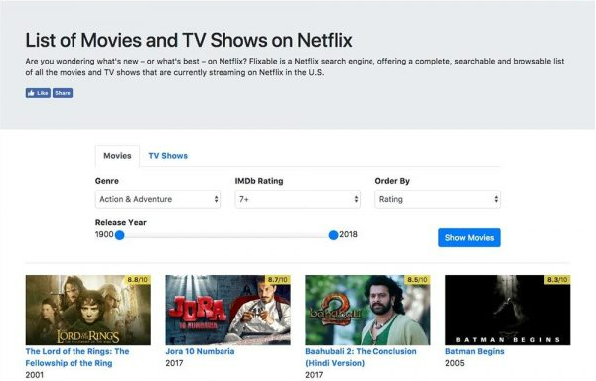
 Problem Statement 
1. This dataset consists of tv shows and movies available on Netﬂix as of 2019.
2. The dataset is collected from Flixable which is a third-party Netﬂix search engine.
3. In 2018, they released an interesting report which shows that the number of TV shows on Netﬂix has nearly tripled since 2010.
4. The streaming service’s number of movies has decreased by more than 2,000 titles since 2010, while its number of TV shows has nearly tripled.
5. It will be interesting to explore what all other insights can be obtained from the same dataset.
6. Integrating this dataset with other external datasets such as IMDB ratings, rotten tomatoes can also provide many interesting findings.

Slide 4
 Workflow Segregation 
Data Description
Data Wrangling & Data Cleaning
Feature Engineering
Conclusion
Model Building
Exploratory Data Analysis (EDA)

Slide 5
 Data Description 
Total Rows= 7787 & Total Features= 12
show_id : Unique ID for every Movie / Tv Show
type : A Movie or TV Show
title : Title of the Movie / Tv Show
director : Director of the movie
cast : Actors involved in the movie / show
country : Country where the movie / show was produced
date_added : Date it was added on Netﬂix
release_year : Actual release year of the movie / show
rating : TV rating of the movie / show
duration : Total duration - in minutes or number of seasons
listed_in : Generes
description: The summary description
Attribute Information:

Slide 6
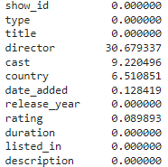



 Data Wrangling & Cleaning 
Information of the data
Null values treatment
Observations
1. Director feature have more than 30.68% of null values. So, we have filled the null values by ‘unknown’ and dropped it.
2. Country feature have 6.51% of null values. So, we have filled the null values by mode of feature.
3. Cast feature have 9.22% of null values. So, we have filled values by ‘unknown’.
4. Rating feature have 0.09% of null values. So, we have filled the null values by mode of feature.
5. Date_added feature have 0.13% of null values. So we have dropped the rows corresponding to null values.

Slide 7
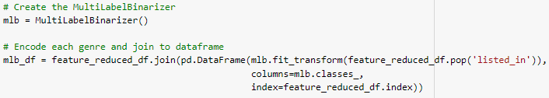

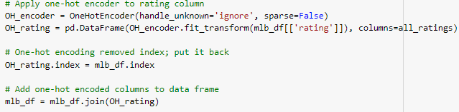
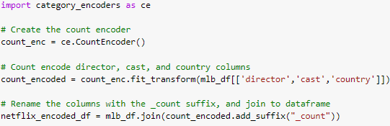
 Feature Engineering 
We have used the MultiLabelBinarizer to encode the genres, the movies or TV shows which are listed in (each entry can belong to multiple genres).
One-hot encoder to encode the rating coloumn.
Further, to enhance the model accuracy along with simplifying and speeding up the data transformations we have added three new features which are date, year and month.
Count encoder to encode the primary director, lead actor or actress, and country of each movie/TV show.

Slide 8
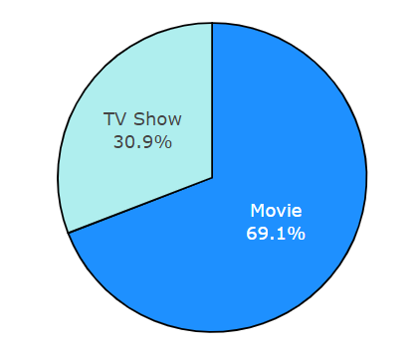
 Exploratory Data Analysis 
Analyzing the entire Netflix dataset consisting of both movies and shows and comparing the total number of movies and shows in this dataset to know which one is the majority.
1. It is evident that there are more movies on Netflix than TV shows.
2. Netflix has 5377 movies, which is more than double the quantity of TV shows.
3. There are about 70% movies and 30% TV shows on Netflix.

Slide 9
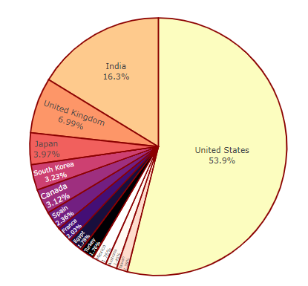
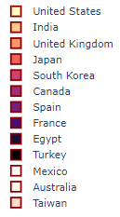
 Exploratory Data Analysis 
Top countries with highest content production
United States has the most number of content on Netflix.
India has second highest content
on Netflix. Australia and Taiwan has least number of content on Netflix.

Slide 10
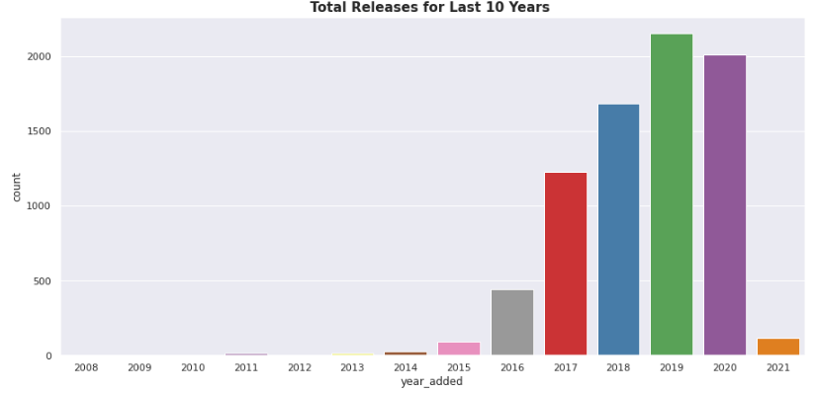
 Exploratory Data Analysis 
The number of release have significantly increased after 2015 and have dropped in 2021 because of Covid 19

Slide 11
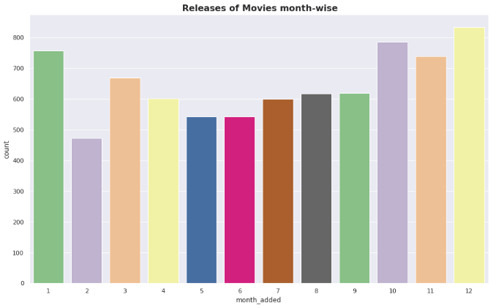
 Exploratory Data Analysis 
More of the content is released in holiday season - October, November, December and January

Slide 12
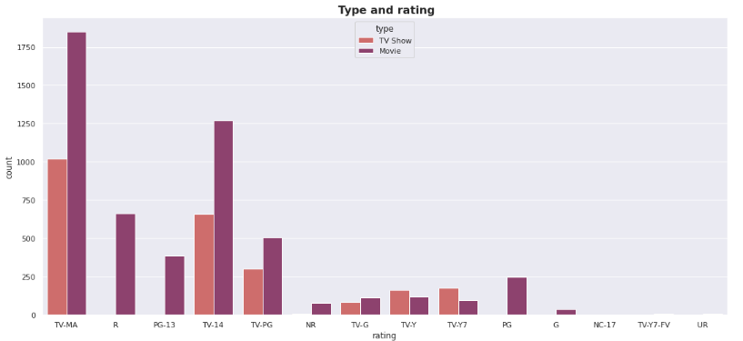
 Exploratory Data Analysis 
Rating wise content count

Slide 13
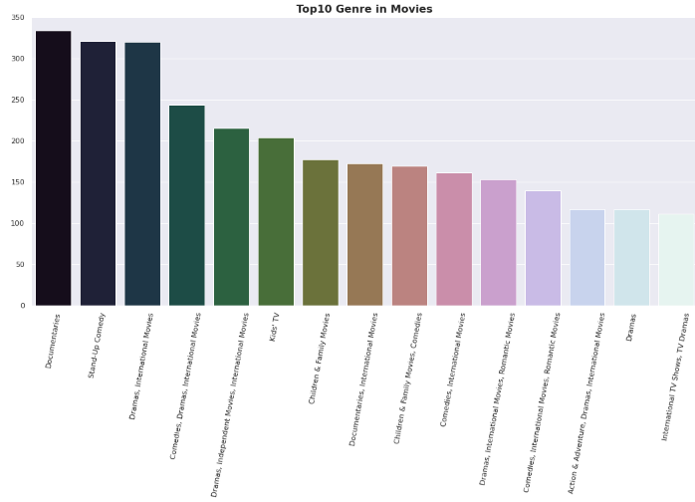
 Exploratory Data Analysis 
Documentaries is the most popular genre followed by comedy.

Slide 14
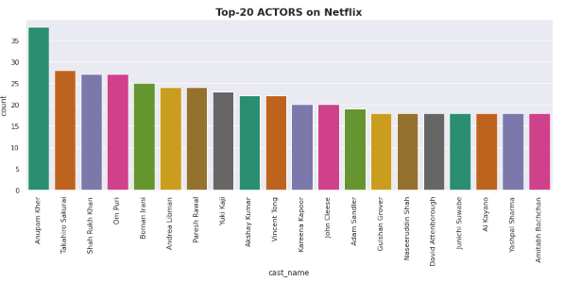
 Exploratory Data Analysis 
Anupam Kher is one of the top actor and has acted in the highest number of films on Netflix.

Slide 15
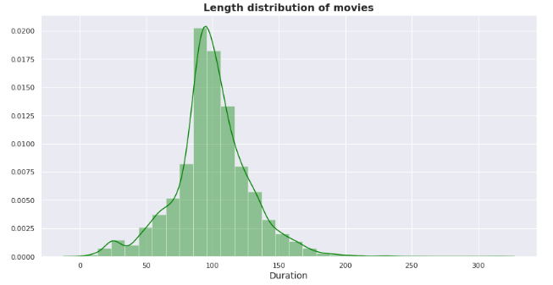
 Exploratory Data Analysis 
Duration distribution of Movies

Slide 16
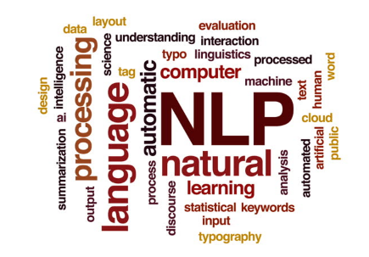

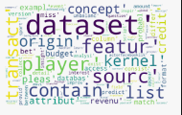
 Exploratory Data Analysis 
Topic modelling is a part of NLP (natural language processing) that is used to determine the topic of a set of documents based on the content. It is an unsupervised approach of recognizing or extracting the topics by detecting the patterns like clustering algorithms and it recognizes the words from the topics present in the document or the corpus of data. This is useful because extracting the words from a document takes more time and is much more complex than extracting them from topics present in the document.
Topic Modelling
Latent Semantic Analysis(LSA) is used to find the hidden topics represented by the document or text. This hidden topics then are used for clustering the similar documents together. LSA is an unsupervised algorithm and hence we don't know the actual topic of the document.
Latent Semantic Analysis
In natural language processing, the Latent Dirichlet Allocation (LDA) is a generative statistical model that allows sets of observations to be explained by unobserved groups that explain why some parts of the data are similar.
Latent Dirichlet Allocation

Slide 17
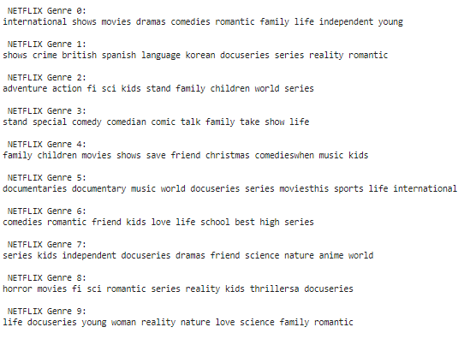
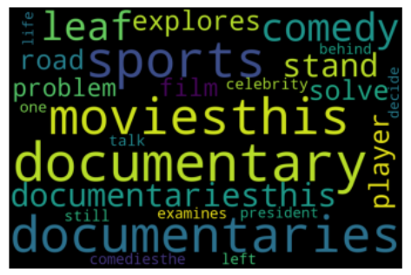
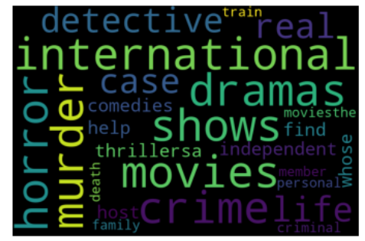
 Exploratory Data Analysis (LDA & LSA) 
We can see that the topic modelling did the genre analysis in movies and tv shows.
Each topic identifies genre of movies an tv shows on netflix.

Slide 18
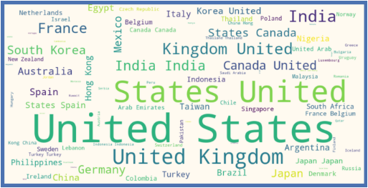
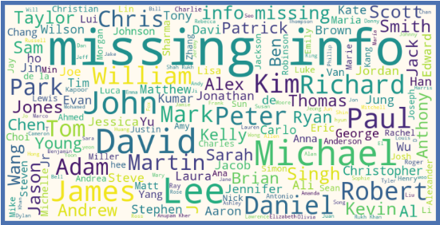
 Exploratory Data Analysis 
Word Cloud for Countries and Cast
A 'word cloud' is a visual representation of word frequency. The more commonly the term appears within the text being analysed, the larger the word appears in the image generated. Word clouds are increasingly being employed as a simple tool to identify the focus of written material.
Countries with the most content available
Which Cast to Choose?

Slide 19
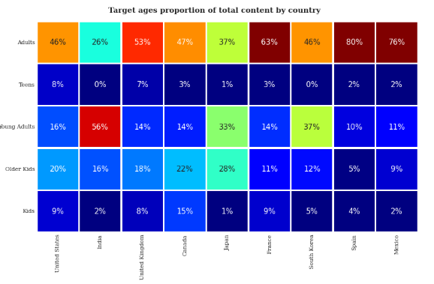
 Exploratory Data Analysis 
Correlation Heatmap
1. It is also interesting to see parallels between culturally comparable nations - the US and UK are closely aligned with their Netflix target ages, but radically different from India or Japan.
2. Also, Mexico and Spain have similar content on Netflix for different age groups.
Observations

Slide 20
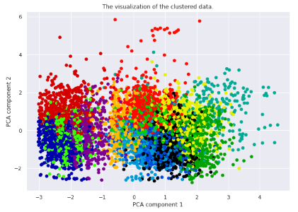
 Model Building 
For clusters model implementation we have implemented three algorithms which are Affinity Propagation, Agglomerative Clustering, K-means Clustering
Aﬃnity Propagation
Affinity Propagation is an unsupervised machine learning algorithm that is particularly well suited for problems where we don't know the optimal number of clusters.
Converged (move toward one point or one another) after 81 iterations. Estimated number of clusters: 13
Silhouette Coefficient: 0.244 which is not that well so we tried some diffrent clustering models.

Slide 21
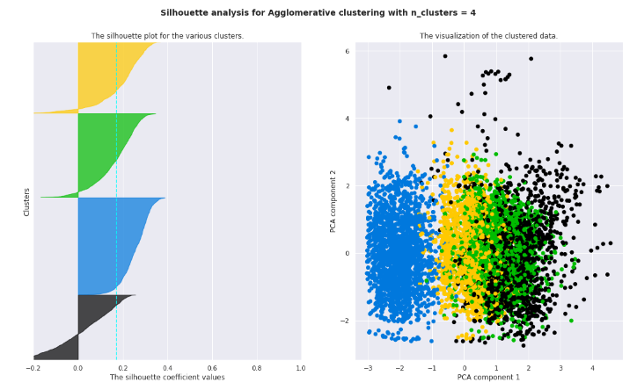
 Model Building 
Agglomerative Clustering
Agglomerative clustering uses a bottom-up approach, wherein each data point starts in its own cluster. These clusters are then joined greedily, by taking the two most similar clusters together and merging them.
Assume we cut vertical lines with a horizontal line to obtain the number of clusters. Number of clusters = 4
The average silhouette_score is : 0.17296314851287742

Slide 22
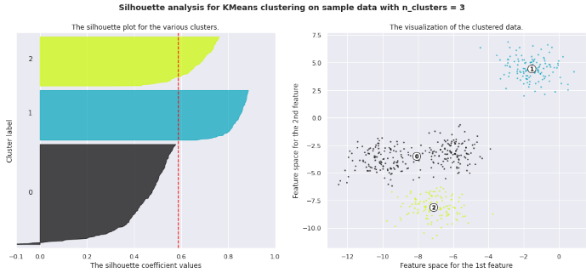
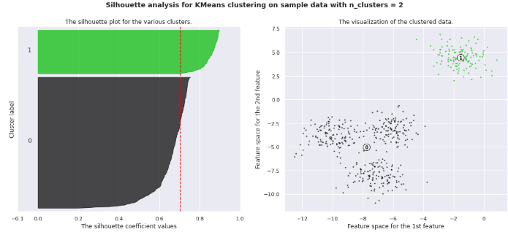
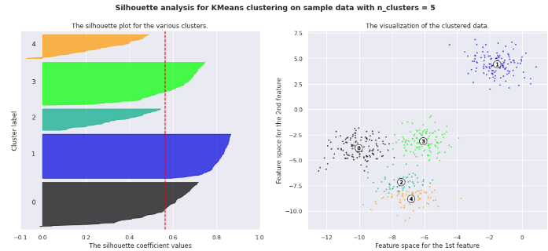
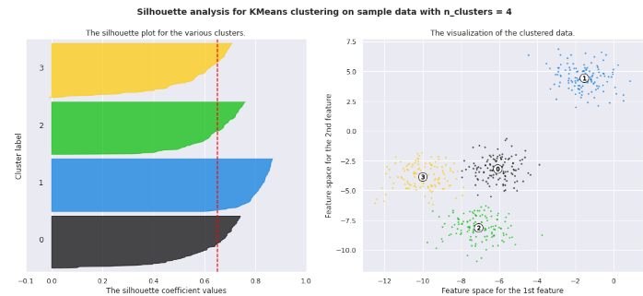
 Model Building 
K-Means Clustering

Slide 23
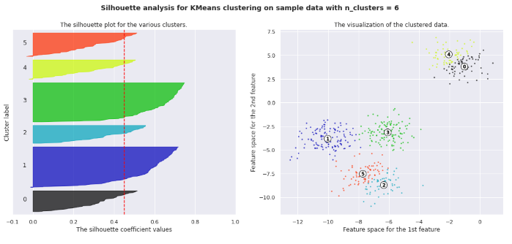

 Model Building 
K-Means Clustering
Observations
1. Silhouette analysis done on these plots to select an optimal value for n_clusters.
2. The value of 4 and 5 for n_clusters looks to be the optimal one. The silhouette score for each cluster is above average silhouette scores.

Slide 24
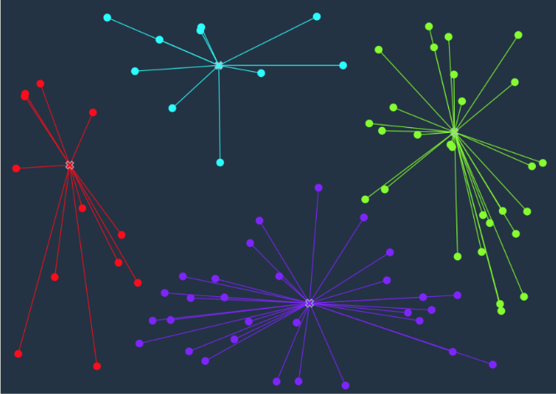
 Model Building 
K-means
To process the learning data, the K-means algorithm in data mining starts with a first group of randomly selected centroids, which are used as the beginning points for every cluster, and then performs iterative (repetitive) calculations to optimize the positions of the centroids.
It halts creating and optimizing clusters when either:
1. The centroids have stabilized — there is no change in their values because the clustering has been successful.
2. The defined number of iterations has been achieved.

Slide 25
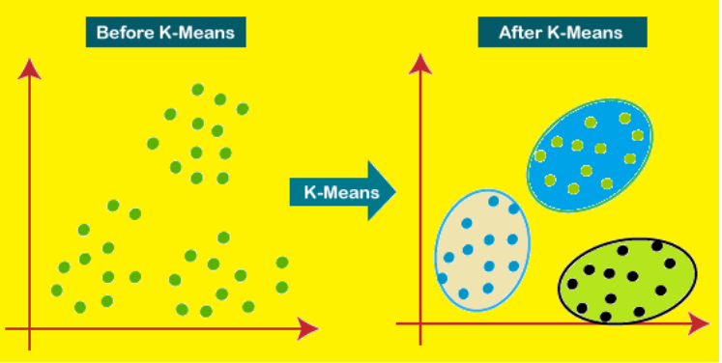
 Model Building 
K-Means Clustering
K-means clustering is an iterative algorithm that tries to partition the dataset into K pre defined distinct non overlapping subgroups where each data point belongs to only one group.

Slide 26
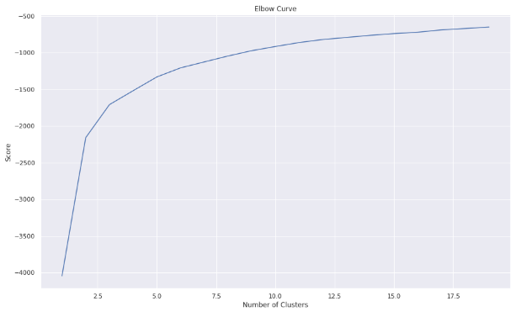
 Model Building 
Elbow Curve
The Elbow Curve is one of the most popular methods to determine the optimal value of k. The elbow curve uses the sum of squared distance (SSE)to choose an ideal value of k based on the distance between the data points and their assigned clusters.

Slide 27
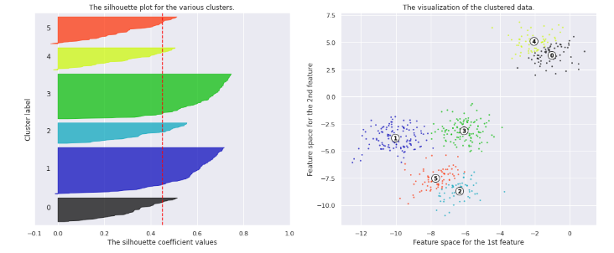
 Model Building 
Silhouette Score
Silhouette score is used to evaluate the quality of clusters created using clustering algorithms such as K Means in terms of how well samples are clustered with other samples that are similar to each other.

Slide 28
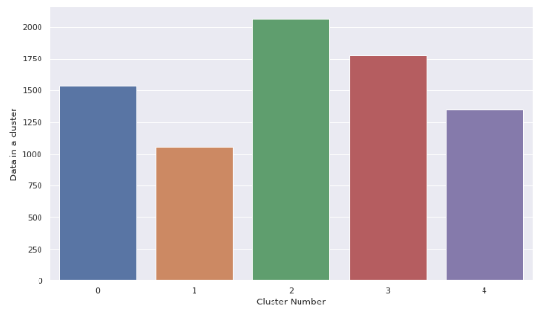
 Model Building 
Visualization of Clusters
We can clearly see that cluster 2 is the largest and cluster 1 has the fewest number of movies.

Slide 29
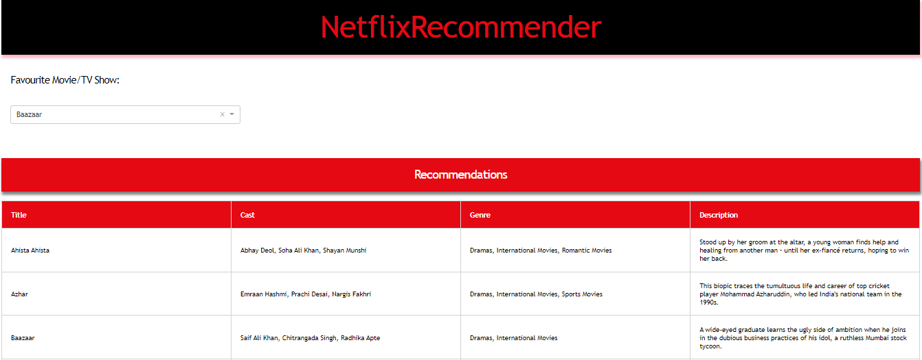
 Run Dashboard App 
Finally, we have created a Flask app that will allow users to input a movie or TV show and it will provide recommendations based on the director, lead actor/actress, genre, and country it was produced in.

Slide 30
 Conclusion 
1. Director and cast contains an astronomically immense number of null values so we have dropped these 2 columns .
2. In this dataset there are two types of contents where 30.86% includes tv shows and the remaining 69.14% carries movies.
3. From the dataset insights we can conclude that the most number of tv shows relinquished in 2017 and for movies it is 2020.
4. The months of October, November, December and January had the largest number of films and Tv-shows released.
5. USA, India, the United Kingdom, Canada, and Egypt are the top five producer countries.
6. For the clustering algorithm, we utilized type, director, nation, released year, genre, and year. LDA and LSA has sorted much more similar titles in a group of genre.
7. In text analysis (NLP) we used stop words, abstracted punctuations , stemming & TF-IDF vectorizer and other functions of NLP.
8. We have applied different clustering models like K-means, hierarchical, agglomerative clustering and we got the best cluster arrangements.
9. We have cut vertical lines with a horizontal line to obtain the number of clusters in Agglomerative Clustering. There were four clusters, with an average silhouette score of 0.17296314851287742.
10. The final model we used was k-means clustering, which consisted of 2,3,4,5,6 clusters. 4 numbers of clusters gives us good fitting. After applying K - means optimal value of number of clusters is 5.
11. Silhouette score for a set of sample data points is used to measure how dense and well-separated the clusters are.
12. We have reached to a conclusion from our analysis that the content integrated over years that Netﬂix is focusing on movies and TV shows (from 2016 data we get acquainted with that, movies are incremented by 80% and tv shows are incremented by 73%).

Slide 31


